Slide 1
The concept of limit
New and difficult concept!

Slide 2
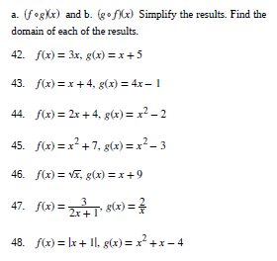
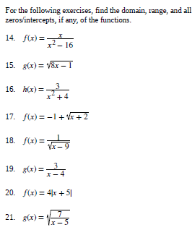

Slide 3
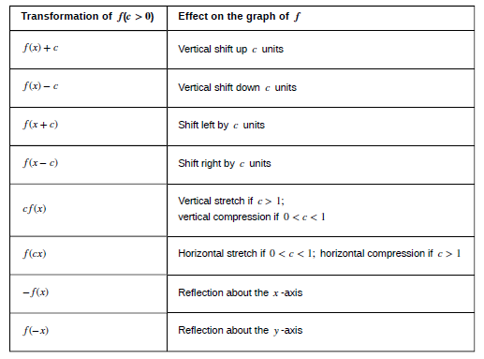

Slide 4
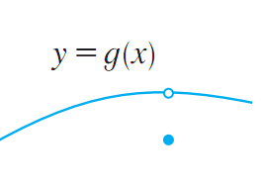
The concept of limit
The most important basic concept in calculus
The concept of limit helps us to see what really happens to a function f(x) as x goes to a.
With this concept, one can manipulate very small and very large quantities.
f(a) = ???: don’t care
What do we care?
What happens here?

Slide 5
When need the concept of limit?
Continuity of functions
Defining derivatives // velocity, tangent line, acceleration, rate of change (next chapter)
Defining integral // calculating areas, distance, volume, length (quantities) (later chapters)
Defining sum of series (later chapters)

Slide 6
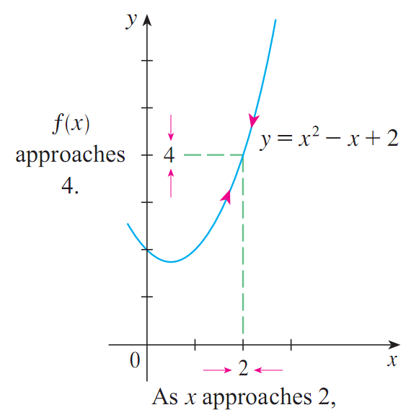
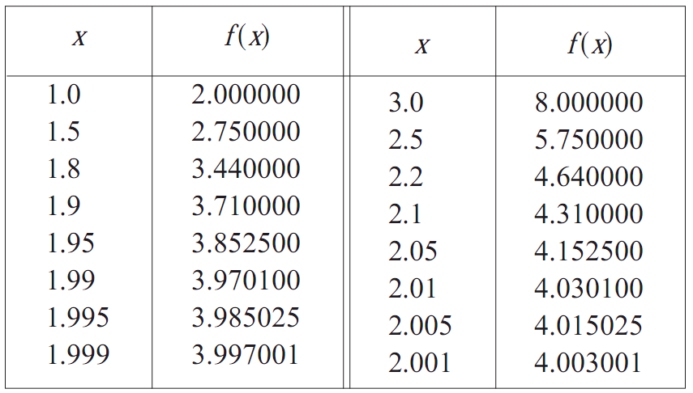
Example
Given f(x) = x² – x + 2
What happens to f(x) when x gets closer to 2 but not equal to 2?
➔ f(x) gets closer to 4.
Step 1
3
Step 2

Slide 7
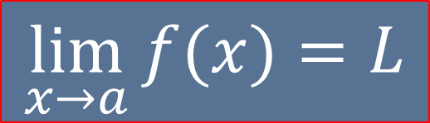
Notation
What happens to f(x) when x gets closer to 2 but not equal to 2?
Answer: 4
4
limf(x) = ?
x → 2
$$\lim_{x→a}{f(x)}=L$$
x goes to a, we never consider x = a
Read: “the limit of , as approaches a, equals L”
f(x) approaches L as x approaches a
f(x) tend to get closer and closer to L as x gets closer and closer to a
f(x) goes to L as x goes to a

Slide 8
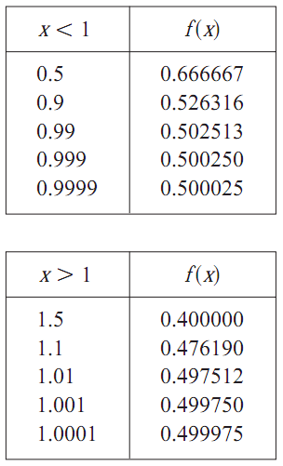

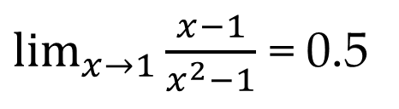

Algebraic method
$$\lim_{x→1}{\frac{x−1}{x^{2}−1}}$$
$\frac{0}{0}=??$?
f(x) is undefined when x = 1, but that doesn’t matter
We want to know what happens to f(x) near 1.
When x gets closer to 1, the values of f(x) are shown in the table at the left
Let make the guess:
$\lim_{x→1}{\frac{x−1}{x^{2}−1}}$ = 0.5

Slide 9
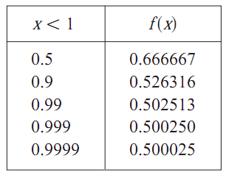

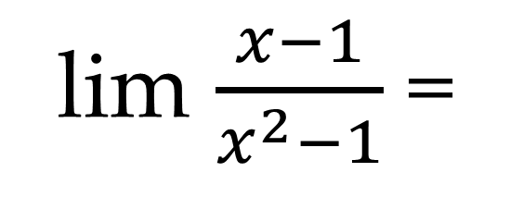
One-sided limits
Given f(x) = $\frac{x−1}{x^{2}−1}$
What happens to f(x) as x gets closer and closer to 1 from the left?
lim $\frac{x−1}{x^{2}−1}$ =
0.5
x → 1⁻
What happen?
x goes to 1, x < 1

Slide 10

Theorem
Left-hand limit:
$$\lim_{x→a^{−}}{f(x)}=L$$
Right-hand limit:
$$\lim_{x→a^{+}}{f(x)}=R$$
If
$\lim_{x→a^{−}}{f(x)}$ =$\lim_{x→a^{+}}{f(x)}=L$
Then
$\lim_{x→a}{f(x)}$= L
Left = right

Slide 11
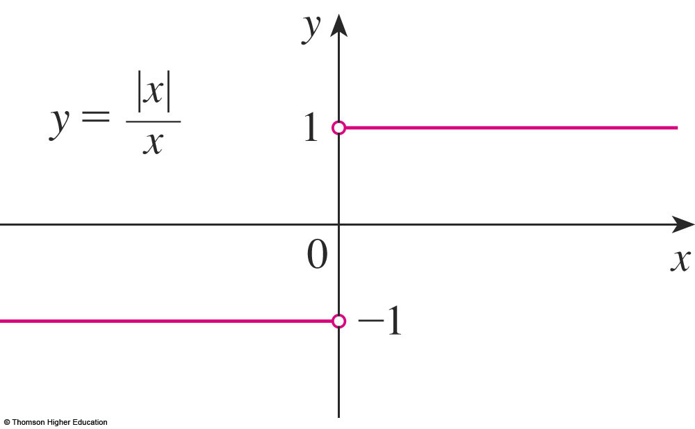
USING THE LIMIT LAWS
Example 4
Prove that does not exist.
Notes:
Use Vertical Test?

Slide 12
Finding limits
Using graphs
Using table of values of f(x)
Using limit laws
Using analytic technique
And more: L’hospital’s rule (ignored)

Slide 13
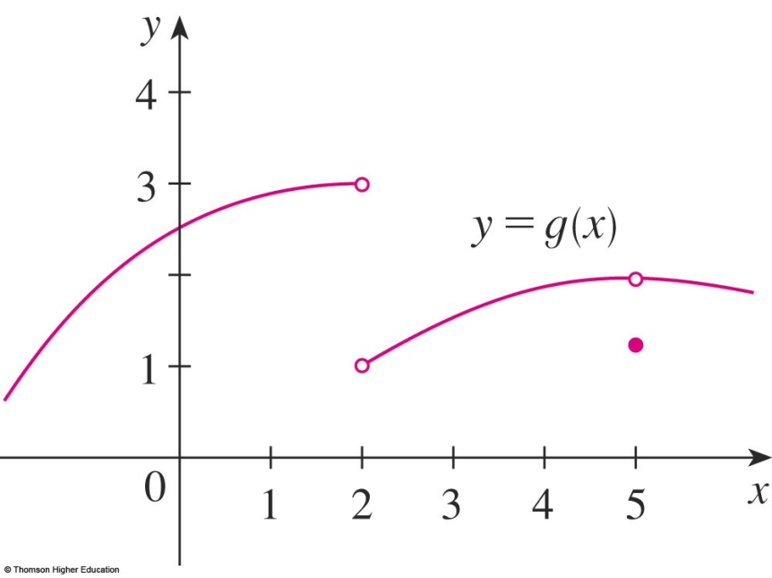
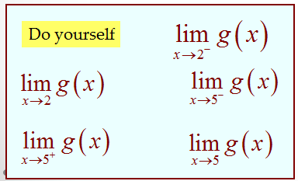
Finding limits. Using graphs.
Using the given graph to find the values of limits.
= 1
x gets closer and closer to 2 from the right, x > 2

Slide 14
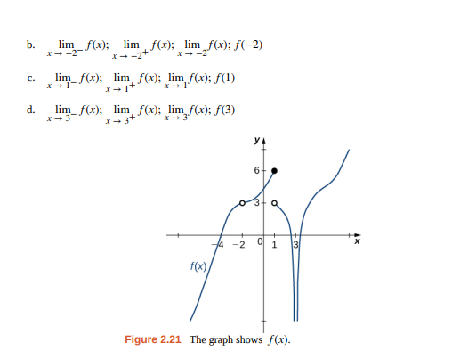

Slide 15
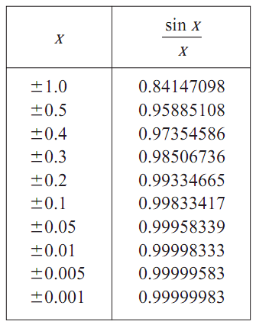



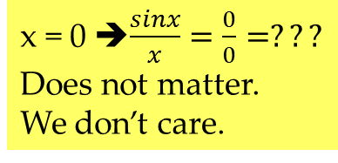
Using table of values of f(x).
Find the limit
$$\lim_{x→0}{\frac{sinx}{x}}$$
x = 0 ➔$\frac{sinx}{x}=\frac{0}{0}=???$
Does not matter.
We don’t care.
We care what happens to $\frac{sinx}{x}$ as x goes to 0?
$$\lim_{x→0}{\frac{sinx}{x}}=1$$

Slide 16
THE LIMIT LAWS
Suppose that c is a constant and the limits and exist. Then

Slide 17
USING THE LIMIT LAWS
where n is a positive integer.

Slide 18
Finding limits
Example
If f(x) = then find lim f(x) = ?
3x – 4, x ≠ 0
10, x = 0,
x → 0
It does not matter that f(0) = 10. For x ≠ 0, and thus for all x near 0,
f(x) = 3x – 4 and therefore lim f(x) = lim (3x – 4) = –4.
x → 0
x → 0

Slide 19
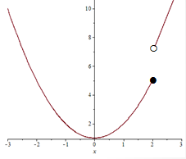
Find the indicated limit
jump
Calculate one sided limits
≠
does not exist
The graph jumps at x =2

Slide 20
Analytic Technique
Find the limit.
WHY?
Answer: x ≠ 3
Using limit laws

Slide 21
Analytic
= - 5

Slide 22

Analytic
Find the value of the limit
$$\lim_{h→0}{\frac{\sqrt{9+h^{2}}−3}{h^{2}}}$$

Slide 23
Do yourself

Slide 24
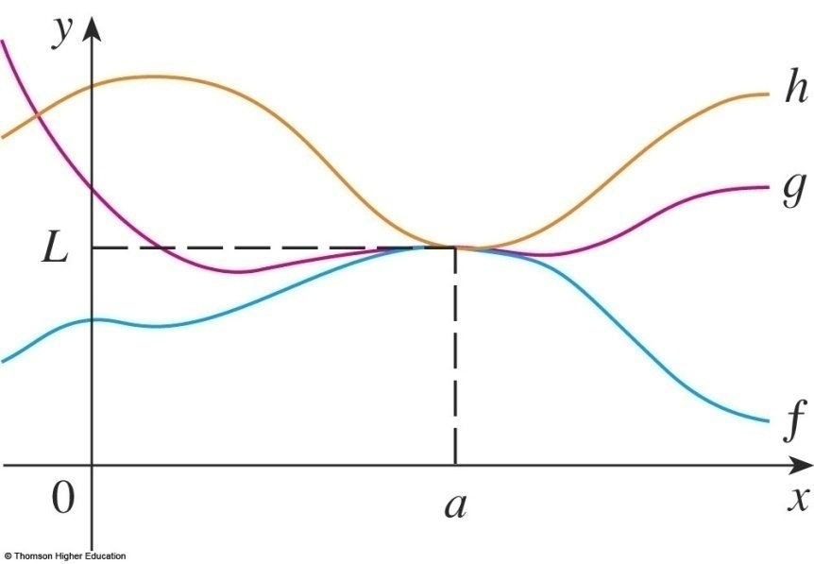
SQUEEZE THEOREM
Theorem 3
The Squeeze Theorem (the Sandwich Theorem or the Pinching Theorem)
?
L

Slide 25
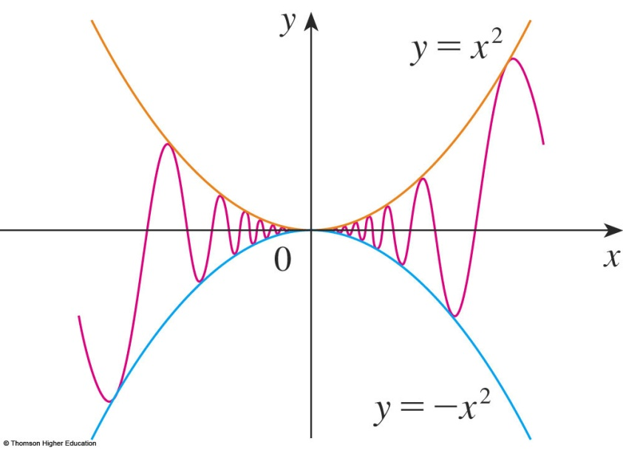
SQUEEZE THEOREM
Example
Find
0

Slide 26
QUIZ QUESTIONS
If
then
a. True b. False
Notes:
For example …

Slide 27
QUIZ QUESTIONS
If
a. True b. False
Notes:
For example …
Then the limit must be

Slide 28
EXERCISES
P176: 93 - 124

Slide 29
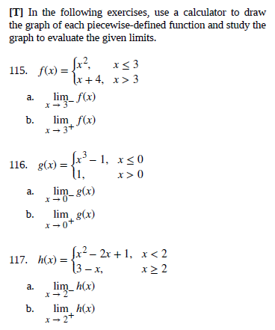
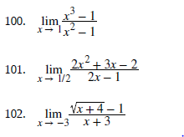
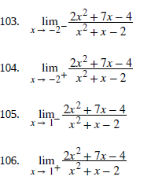

Slide 30

Limits involving infinity
Some useful notes:
$$\frac{number}{∞}=0$$
$\frac{∞}{5}=∞$
$\frac{∞}{∞}=no conclusion$
∞ + ∞ = ∞, ∞.∞ = ∞
∞ - ∞ = no conclusion
$\frac{ ≠ 0}{ 0}=$ ∞

Slide 31
Continuity
Small change in f(x) for small change in x
Continuous functions ➔ easy to find their limits.

Slide 32
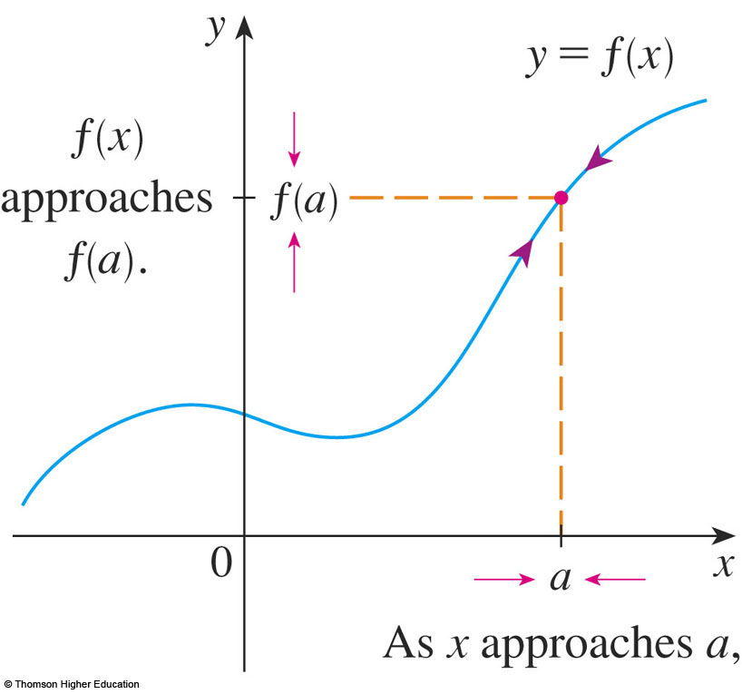
CONTINUITY
1. Definition
A function f is continuous at a number a if:
Notice that :
f(a) is defined - that is, a is in the domain of f
exists.

Slide 33
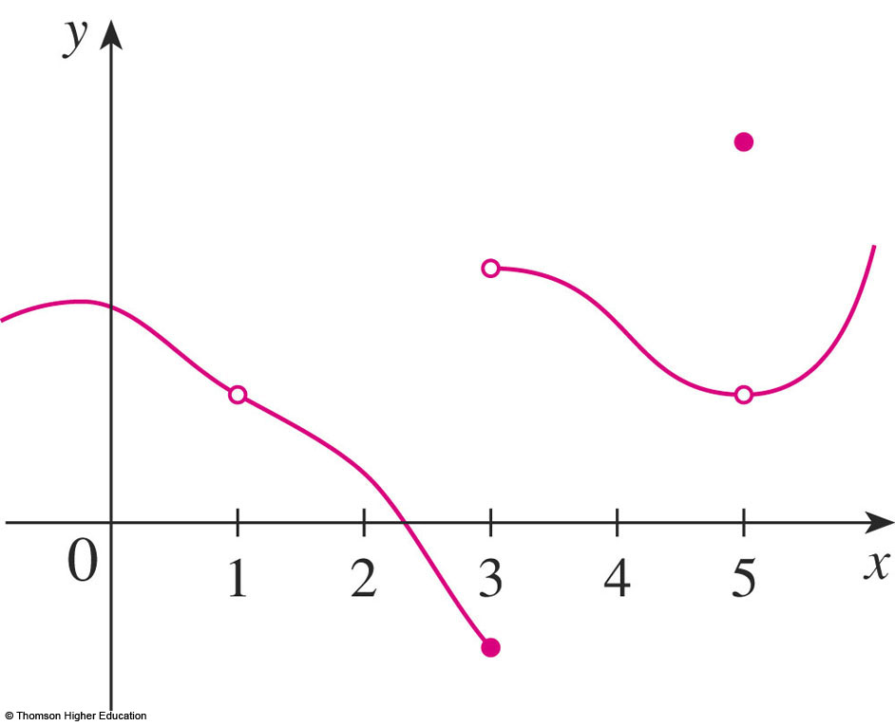
CONTINUITY
Definition
Discontinuous at a = NOT continuous at a.
At x = 5: f(5) ≠ lim_{x→5} f(x) ➔ discontinuous at x = 5
f(5)
At x = 3: large change in f(x) for small change in x. In fact,
left side limit ≠ right side limit
➔ Discontinuous at x = 3
jump
jump
At x = 1: f(1) is undefined ➔ discontinuous at x = 1

Slide 34
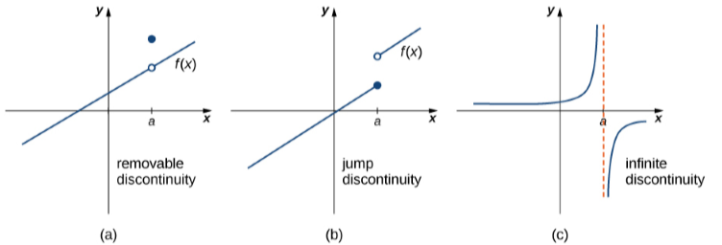
CONTINUITY

Slide 35
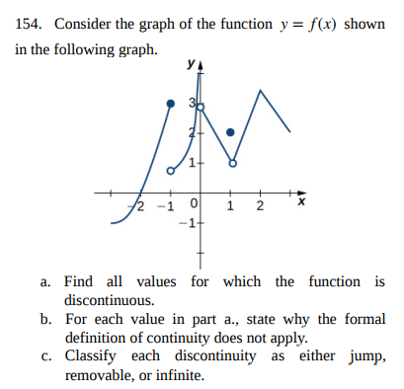

Slide 36
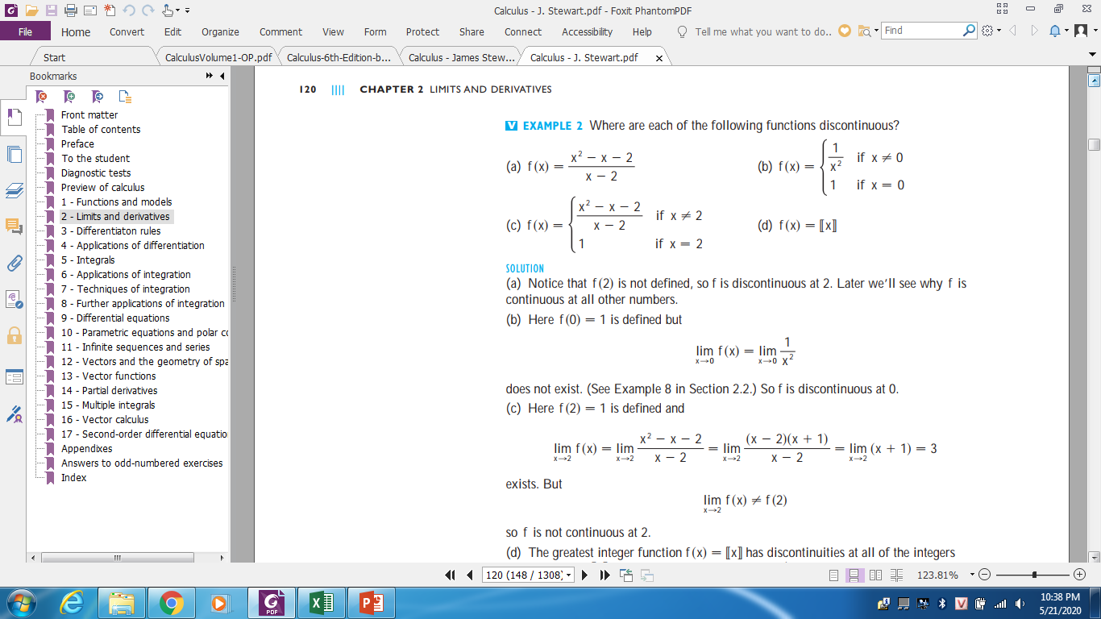
SOLUTION (a) Notice that f(2) is not defined, so f is discontinuous at 2. Later we’ll see why is continuous at all other numbers

Slide 37
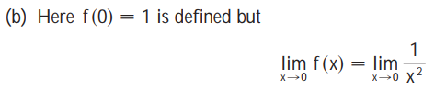
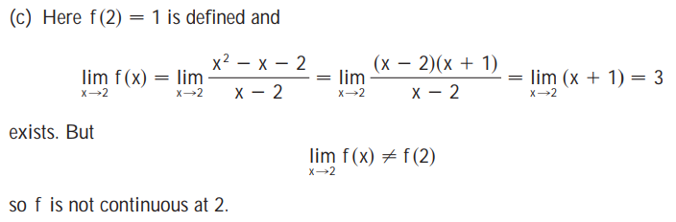
does not exist. So f is discontinuous at 0.

Slide 38
Exploring Continuity
Step 2
Step 1. f(1) = 4
Step 3
f is continuous at 1 ➔ m, c =???

Slide 39
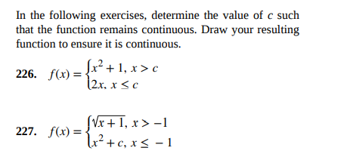

Slide 40
CONTINUITY
Theorem
If f and g are continuous at a; and c is a constant, then the following functions are also continuous at a:
1. f + g
2. f - g
3. cf
4. fg
5.
old cont. functions
new ones
by +, - , . , /

Slide 41
CONTINUITY
7. Theorem
Always continuous (in the specific domains):
Polynomials // hàm đa thức
Rational functions // hàm hữu tỉ
Root functions // hàm căn thức
Trigonometric functions // hàm lượng giác

Slide 42
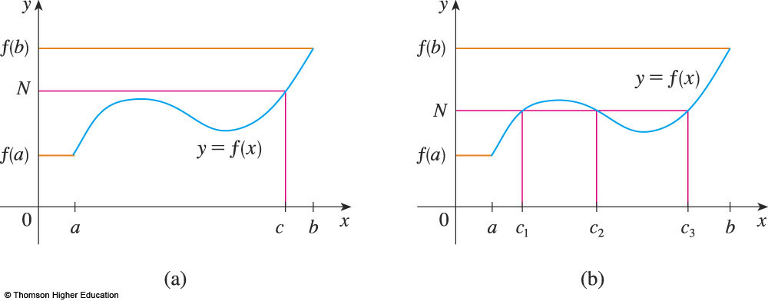
INTERMEDIATE VALUE THEOREM
Theorem
f(c) = N
for some c in (a, b)
Values of f(x) change continuously from f(a) to f(b)

Slide 43
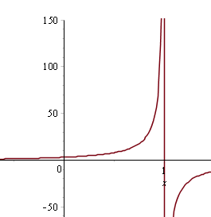

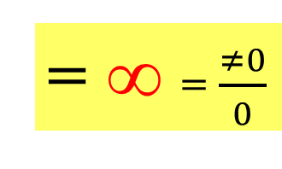
Asymptotes
Given f(x) = $\frac{2x+3}{1−x}$
What happens to f(x) when x goes to 1 from the left?
In other word, what is
$$\lim_{x→1^{−}}{\frac{2x+3}{1−x}}???$$
= ∞ = $\frac{≠0}{0}$
Vertical Asymptote
x =1
1

Slide 44
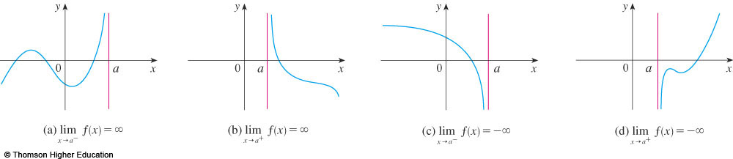
DEFINITIONS
x=a is called the vertical asymptote of f(x) if we have one of the following:

Slide 45
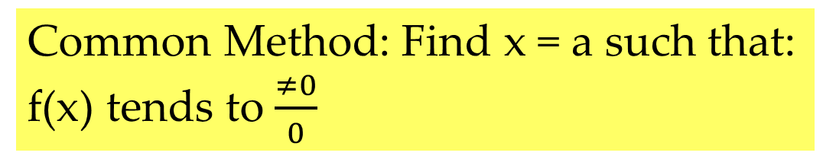
Find Vertical Asymptotes. (x = a)
Common Method: Find x = a such that:
f(x) tends to $\frac{≠0}{0}$
A graph maybe have:
no vertical asymptote (T)
only one (T)
Five (T)
Infinity (T)
TRUE OR FALSE?

Slide 46
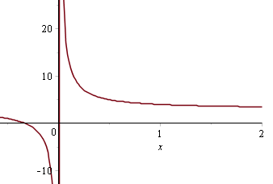
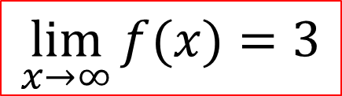

Asymptotes
f(x) = $\frac{3x+1}{x}$
$$\lim_{x→∞}{f(x)}=3$$
3
HORIZONTAL asymptote y = 3
f(x) approaches 3 as x goes to infinity

Slide 47
Find horizontal Asymptotes (y = L)
Identify any vertical asymptotes:
A graph maybe have:
no horizontal asymptote (T)
only one (T)
Two (T)
More than two (False)
TRUE OR FALSE?

Slide 48
Example
Find the asymptotes of the function
Solution
y=1 is horizontal asymptote

Slide 49
Example
Compute
a.
b.
c.
d.
0
0
Does not exist
Notes:
Using limit laws

Slide 50
QUIZ QUESTIONS
1) Find
a. 0 b. infinity c. 1 d. Does not exist
2) Find
a. 0 b. infinity c. 1 d. Does not exist
Notes:
2. Squeenze theorem

Slide 51
QUIZ QUESTIONS
3) If
Then
a. True b. False
4) A function can have two different horizontal asymptotes
a. True b. False
Notes:
For example…

Slide 52
Summary
Limit of functions
How to calculate limits
Continuity
Asymptotes

Slide 53
THANKS

